Slide 1
STACK
DATA STRUCTURE

Slide 2
Introduction
Stack is an important data structure which stores its elements in an ordered manner.
Stack is called a LIFO (Last-In-First-Out) data structure

Slide 3
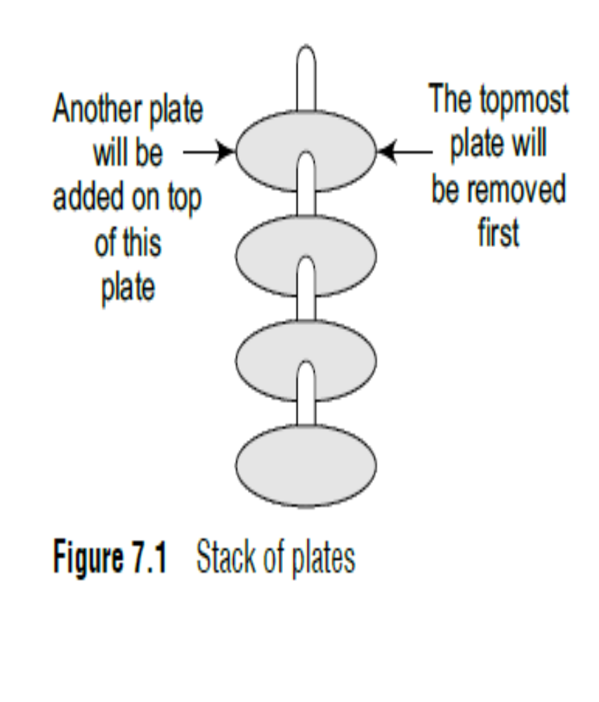
Stacks can be understood using an analogy
You must have seen a pile of plates where one plate is placed on top of another as shown in Fig.
Now, when you want to remove a plate, you remove the topmost plate first. Hence, you can add and remove an element (i.e., a plate) only at/from one position which is the topmost position.
A stack is a linear data structure which uses the same principle, i.e.,
the elements in a stack are added and removed only from one end,
which is called the TOP.
Hence, a stack is called a LIFO (Last-In-First-Out) data structure,
as the element that was inserted last is the first one to be taken out.

Slide 4
Example
1. Suppose we are executing function A. In the course of its execution, function A calls another function B. Function B in turn calls another function C, which calls function D.
2. In order to keep track of the returning point of each active function, a special stack called system stack or call stack is used. Whenever a function calls another function, the calling function is pushed onto the top of the stack. This is because after the called function gets executed, the control is passed back to the calling function.
3. Now when function E is executed, function D will be removed from the top of the stack and executed. Once function D gets completely executed, function C will be removed from the stack for execution. The whole procedure will be repeated until all the functions get executed.
4.The system stack ensures a proper execution order of functions. Thus, stacks are frequently used in situations where the order of processing is very important, especially when the processing needs to be postponed until other conditions are fulfilled.

Slide 5
Example
Void A( )
{
Void B( )
{
Void C( )
{
Void D( )
{
Function D( )
Function D( )
Void E( )
{
Statement 1;
Statement 2;
}
Function C( )
Function C( )
Function B( )
Function B( )
Function A( )
Function A( )
}
SYSTEM STACK IN CASE OF FUNCTION CALL
STACK WHEN A CALLED FUNCTION RETURNS TO THE CALLING FUNCTION
}
}
}

Slide 6
STACKS… CAN BE IMPLEMENTED
USING ARRAYS
USING LINKED LIST

Slide 7
ARRAY IMPLEMENTATION OF STACK
In computer memory stacks can be represented as linear Array.
Every stack has a variable called TOP associated with it which is used to store the address of topmost element of stack.
It is the position from where the elements will be deleted or add from.
There is one more variable called MAX which stores the maximum number of elements a stack can hold.
If TOP = NULL
If TOP = MAX-1
STACK IS FULL
Represents Stack is Empty

Slide 8
ARRAY IMPLEMENTATION OF STACK
Insertion
Deletion
4
Top=4
In a stack all operation like insertion and deletion are performed at only one end called Top
3
2
1
0

Slide 9
Operations on STACK using Array ?
Creation
Insertion
Deletion
Peek
Displaying

Slide 10
Operations on STACK ?
4
Creation
#define SIZE 5
int stack[SIZE];
3
Insertion
2
Deletion
1
Peek
0
Displaying
stack

Slide 11
Operations on STACK ?
Insertion operation is called as “push”
4
Creation
The push operation is used to insert an element into the stack.
The new element is added at the topmost position of the stack.
However, before inserting the value, we must first check if TOP=MAX–1, because if that is the case, then the stack is full and no more insertions can be done.
If an attempt is made to insert a value in stack that is already full, an OVERFLOW message is printed.
3
Insertion
2
Deletion
1
Peek
0
Displaying
stack

Slide 12
Operations on STACK ?
Insertion operation is called as “push”
4
Creation
Algorithm push(element, stack[] )
{
  If < TOP==MAX-1> do
  write “OVERFLOW”;
  Else do
  {
  Top++;
  stack[Top] := element;
  }
}
3
Insertion
2
Deletion
1
Peek
0
Displaying
stack

Slide 13
Operations on STACK ?
Deletion operation is called as “pop”
The pop operation is used to delete the topmost element from the stack.
However, before deleting the value, we must first check if TOP=NULL because if that is the case, then it means the stack is empty and no more deletions can be done.
If an attempt is made to delete a value from a stack that is already empty, an UNDERFLOW message is printed.
4
Creation
3
Insertion
2
Deletion
1
Peek
0
Displaying
stack

Slide 14
Operations on STACK ?
Deletion operation is called as “pop”
Algorithm Pop(stack[] )
{
  If <TOP==NULL> do
  {
  write “UNDERFLOW”;
  return TOP;
  }
  Else do
  {
  deleted := stack[TOP];
  Top--;
  return deleted;
  }
}
4
Creation
3
Insertion
2
Deletion
1
Peek
0
Displaying
stack

Slide 15
Operations on STACK ?
Deletion operation is called as “peek”
4
Creation
Peek is an operation that returns the value of the topmost element of the stack without deleting it from the stack.
However, the Peek operation first checks if the stack is empty, i.e., if TOP = NULL, then an appropriate message is printed, else the value is returned.
3
Insertion
2
Deletion
1
Peek
0
Displaying
stack

Slide 16
Operations on STACK ?
Deletion operation is called as “peek”
4
Creation
3
Algorithm Peek( stack[] )
{
  If <Stack is Empty> do
  write “STACK EMPTY!!!”;
  else
  return stack[TOP];
}
Insertion
2
Deletion
1
Peek
0
Displaying
stack

Slide 17
Operations on STACK ?
Algorithm Display( stack[] )
{
  If <TOP==NULL> do
  write “STACK EMPTY!!!”;
  else
  {
  for i:=Top to i>-1
  write stack[i];
  }
}
4
Creation
3
Insertion
2
Deletion
1
Peek
0
Displaying
stack

Slide 18





Linked List Representation of Stack
If the Array size cannot be determined in advance then the Linked List Representation of Stack is used
In a Linked Stack every Node has two part data + next.
The HEAD pointer of linked List is used as TOP. All insertion and deletion are done at the Node pointed by TOP.
If TOP==NULL ---→ STACK EMPTY

Slide 19
Operations on STACK using Linked List?
Creation
Insertion
Deletion
Peek
Displaying

Slide 20

Operations on LINKED STACK ?
Insertion operation is called as “push”
The push operation is used to insert an element into the stack.
The new element is added at the topmost position of the stack.
However, before inserting the value, we must first check if TOP=NULL, because if that is the case, then we have to allocate memory for new Node.
However, if TOP!=NULL, then we insert the new node at the beginning of the linked stack and name this new node as TOP.
5
Creation
4
Insertion
3
Deletion
2
Peek
1
Displaying
stack

Slide 21
Operations on LINKED STACK ?
Insertion operation is called as “push”
Algorithm push( TOP, data )
{
//Allocate memory for the new node and name it as NEW_NODE
  Node *temp:= new Node;
  temp->data:=data;
  If < TOP==NULL> do
  temp->next:=NULL;
  TOP:=temp;
  Else do
  {
  temp->next:=TOP;
  Top := temp;
  }
}
5
Creation
4
Insertion
3
Deletion
2
Peek
1
Displaying
stack

Slide 22
Operations on STACK ?
Deletion operation is called as “pop”
The pop operation is used to delete the topmost element from the stack.
However, before deleting the value, we must first check if TOP=NULL because if that is the case, then it means the stack is empty and no more deletions can be done.
If an attempt is made to delete a value from a stack that is already empty, an UNDERFLOW message is printed.
5
Creation
4
Insertion
3
Deletion
2
Peek
1
Displaying
stack

Slide 23
Operations on LINKED STACK ?
Deletion operation is called as “pop”
Algorithm Pop(TOP )
{
  If <TOP==NULL> do
  {
  write “UNDERFLOW”;
  return TOP;
  }
  Else do
  {
  ptr := TOP;
  TOP:=TOP->next;
  delete ptr;
  }
}
5
Creation
4
Insertion
3
Deletion
2
Peek
1
Displaying
stack

Slide 24
Operations on LINKED STACK ?
Deletion operation is called as “peek”
5
Creation
4
Algorithm Peek( TOP)
{
  If <TOP==NULL> do
  write “STACK EMPTY!!!”;
  else
  return TOP->data;
}
Insertion
3
Deletion
2
Peek
1
Displaying
stack

Slide 25
Operations on LINKED STACK ?
Algorithm Display( stack[] )
{
ptr:=TOP;
  If <TOP==NULL> do
  write “STACK EMPTY!!!”;
  else
  {
  while <ptr!=NULL> do
  write ptr->data;
  ptr:=ptr->next;
  }
}
5
Creation
4
Insertion
3
Deletion
2
Peek
1
Displaying
stack

Slide 26
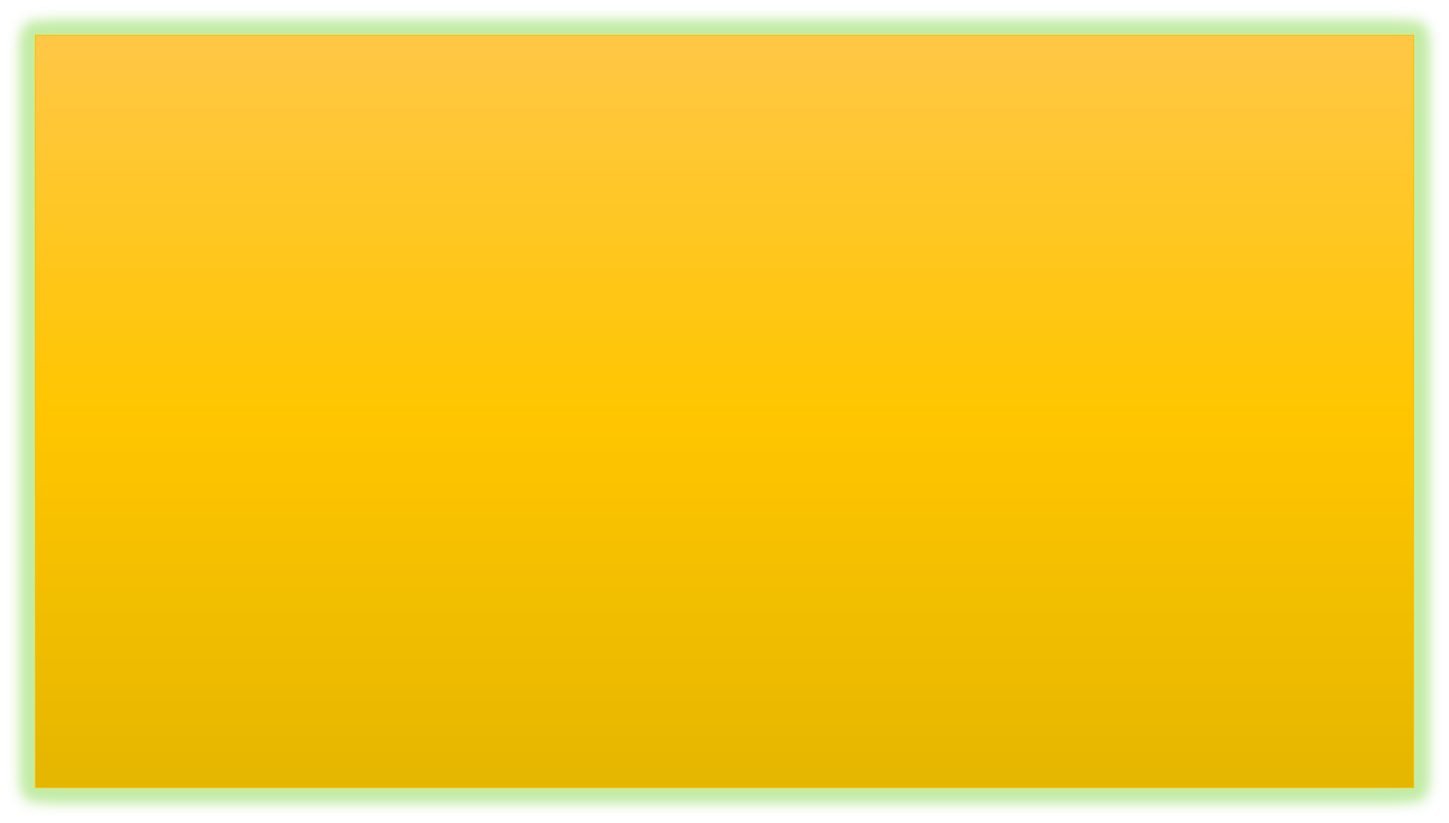
APPLICATIONS OF STACKS
Reversing a list
Parentheses checker
Conversion of an infix expression into a postfix expression
Evaluation of a postfix expression
Conversion of an infix expression into a prefix expression
Evaluation of a prefix expression
Recursion
Tower of Hanoi

Slide 27
Tower of Hanoi
THE PUZZLE
APPROACH
  Tower of Hanoi is a mathematical puzzle where we have three rods and n disks. The objective of the puzzle is to move the entire stack to another rod, obeying the following simple rules:
  1) Only one disk can be moved at a time.
  2) Each move consists of taking the upper disk from one of the stacks and placing it on top of another stack i.e. a disk can only be moved if it is the uppermost disk on a stack.
  3) No disk may be placed on top of a smaller disk.
  Take an example for 2 disks :
  Let rod 1 = 'A', rod 2 = 'B', rod 3 = 'C'.
  Step 1 : Shift first disk from 'A' to 'B'.
  Step 2 : Shift second disk from 'A' to 'C'.
  Step 3 : Shift first disk from 'B' to 'C'.
  The pattern here is :
  Shift 'n-1' disks from 'A' to 'B'.
  Shift last disk from 'A' to 'C'.
  Shift 'n-1' disks from 'B' to 'C'.

Slide 28



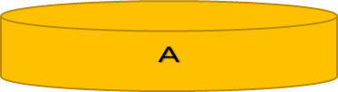
Tower of Hanoi

Slide 29


Tower of Hanoi

Slide 30



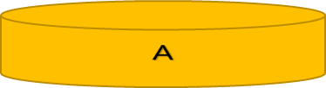
Tower of Hanoi

Slide 31
Tower of Hanoi

Slide 32
Tower of Hanoi
Algorithm TowerOfHanoi ( n, from_rod, to_rod, aux_rod )
{
if < n == 1 > do
{
write "Move disk " n " from rod " from_rod " to rod " to_rod ;
return;
}
TowerOfHanoi ( n - 1, from_rod, aux_rod, to_rod );
write "Move disk " n " from rod " from_rod " to rod " to_rod ;
TowerOfHanoi (n - 1, aux_rod, to_rod, from_rod );
}

Slide 33
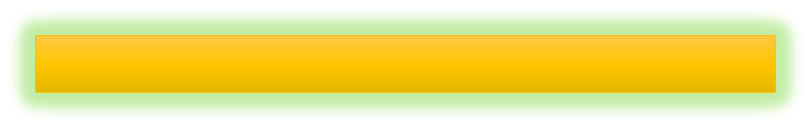
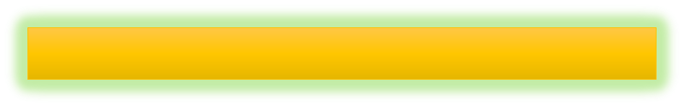
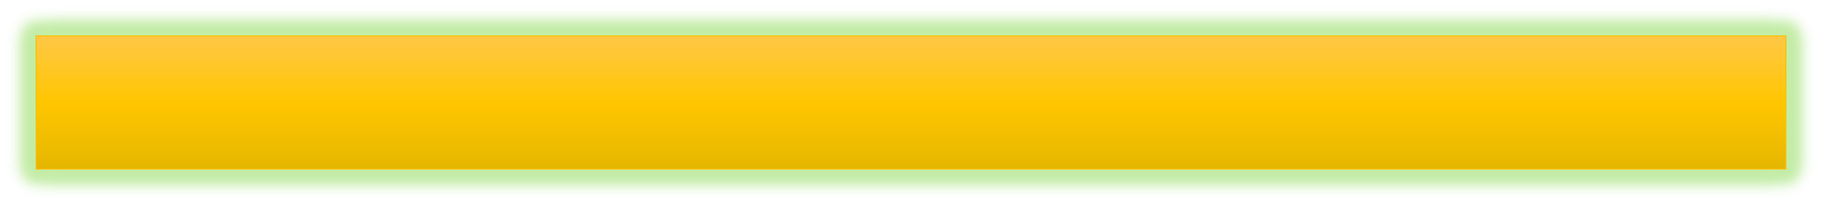
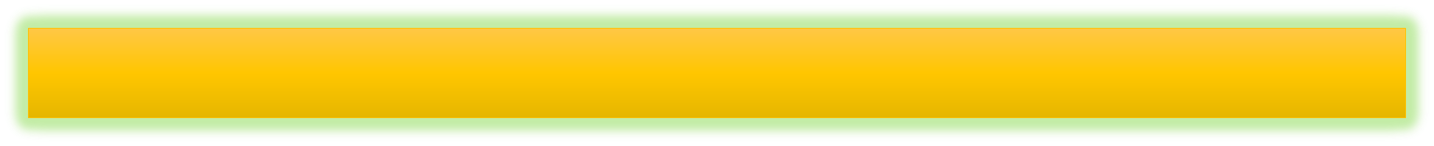
Algorithm to convert an infix notation to postfix notation
The algorithm uses a stack to temporarily hold operators. The postfix expression is obtained from left-to-right using the operands from the infix expression and the operators which are removed from the stack. The first step in this algorithm is to push a left parenthesis on the stack and to add a corresponding right parenthesis at the end of the infix expression. The algorithm is repeated until the stack is empty.
1) Scan the given expression from left to right
2) First operator seen is simply pushed onto stack
3) If we see an operand, append it to the postfix expression.
4) If we see an operator (x) whose precedence is lower , pop off all the operators which are of higher precedence than ‘x’ and append them to the postfix expression. Then, push the operator ‘x’ onto stack.
5) If we see an opening parenthesis, simply push it onto stack
6) If we see a closing parenthesis, pop off all elements from stack till opening parenthesis and append them to postfix expression except the opening & closing parenthesis
7) Finally, pop off all the elements (operators) from stack till it’s empty and append them to postfix expression

Slide 34
Convert the following infix expression into postfix expression using the algorithm
INFIX CHARACTER SCANNED | STACK | POSTFIX EXPRESSION
 | (
A | ( | A
- | ( - | A
( | ( - ( | A
B | ( - ( | A B
/ | ( - ( / | A B
C | ( - ( / | A B C
+ | ( - ( + | A B C /
( | ( - ( + ( | A B C /
D | ( - ( + ( | A B C / D
% | ( - ( + ( % | A B C / D
E | ( - ( + ( % | A B C / D E
* | ( - ( + ( % * | A B C / D E
F | ( - ( + ( % * | A B C / D E F

Slide 35
) | ( - ( + | A B C / D E F * %
/ | ( - ( + / | A B C / D E F * %
G | ( - ( + / | A B C / D E F * % G
) | ( - | A B C / D E F * % G / +
* | ( - * | A B C / D E F * % G / +
H | ( - * | A B C / D E F * % G / + H
) |  | A B C / D E F * % G / + H * -
A B C / D E F * % G / + H * -

Slide 36
Evaluation of a Postfix Expression
Given an algebraic expression written in infix notation, the computer first converts the expression into the equivalent postfix notation and then evaluates the postfix expression
Both these tasks—converting the infix notation into postfix notation and evaluating the postfix expression—make extensive use of stacks as the primary tool
Every character of the postfix expression is scanned from left to right.
If the character encountered is an operand, it is pushed on to the stack.
However, if an operator is encountered, then the top two values are popped from the stack and the operator is applied on these values.
The result is then pushed on to the stack.

Slide 37
ALGORITHM TO EVALUATE THE POSTFIX EXPRESSION
Add a “)” at the end of the post fix expression.
Scan every character of the postfix expression and repeat step 3 and 4 until “) “ is encountered.
If an operand is encountered
push it onto STACK.
If a operator is encountered then
a. POP two top elements of STACK as A and B.
b. Evaluate B operator A ( where A topmost and B is element below it)
c. PUSH the result onto STACK.
4. Result = TOP of STACK
5. Exit

Slide 38
CONVERSION OF AN INFIX TO PREFIX EXPRESSION
Scan each character in the infix expression. For this, repeat Steps 2-8 until the end of infix expression
Push the operator into the operator STACK and operand into the operand STACK, ignore all left parenthesis until a right parenthesis is encountered.
Pop operand 2 from operand stack.
Pop operand 1 from operand stack’
Pop operator from operator stack
Concatenate operator and operand 1
Concatenate result with operand 2
Push result into the operand stack
END

Slide 39
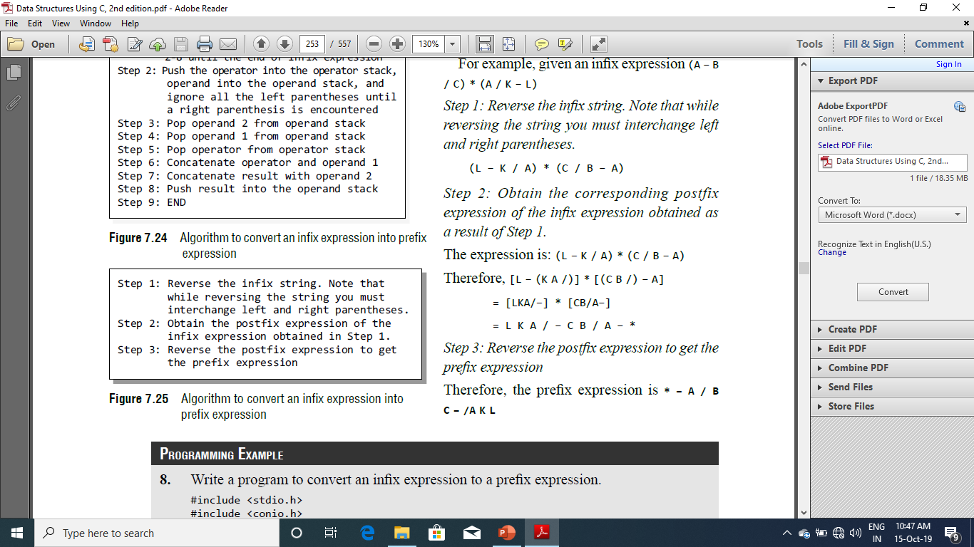
CONVERSION OF AN INFIX TO PREFIX EXPRESSION
Method 2

Slide 40
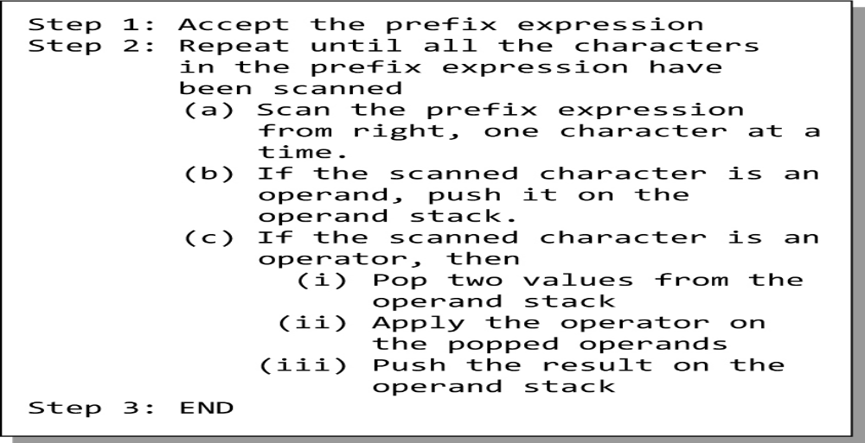
Algorithm for evaluation of a prefix expression

Slide 41


QUEUE
Queue is a linear data structure where the first element is inserted from one end called REAR and deleted from the other end called as FRONT.
Front points to the beginning of the queue and Rear points to the end of the queue.
Queue follows the FIFO (First - In - First Out) structure.
In a queue, one end is always used to insert data (enqueue) and the other is used to delete data (dequeue), because queue is open at both its ends.
The enqueue() and dequeue() are two important functions used in a queue.

Slide 42


QUEUE Analogy
People waiting for a bus. The first person standing in the line will be the first one to get into the bus.
People standing outside the ticketing window of a cinema hall. The first person in the line will get the ticket first and thus will be the first one to move out of it.
Luggage kept on conveyor belts. The bag which was placed first will be the first to come out at the other end.
Cars lined at a toll bridge. The first car to reach the bridge will be the first to leave.
We see that the element at the first position is served first.
Same is the case with queue data structure.
A queue is a FIFO (First-In, First-Out) data structure in which the element that is inserted first is the first one to be taken out.
The elements in a queue are added at one end called the REAR and removed from the other end called the FRONT.
Queues can be implemented by using either arrays or linked lists.

Slide 43
ARRAY REPRESENTATION OF QUEUEs
In Fig FRONT = 0 and REAR = 5. Suppose we want to add another element with value 45, then REAR would be incremented by 1 and the value would be stored at the position pointed by REAR.
The queue after addition would be as shown in Fig. Here, FRONT = 0 and REAR = 6.
Every time a new element has to be added, we repeat the same procedure.
Queue---→
12 | 10 | 100 | 40 | 50 | 02
Index---→
0 | 1 | 2 | 3 | 4 | 5
Front
Rear
12 | 10 | 100 | 40 | 50 | 02
45
0 | 1 | 2 | 3 | 4 | 5
6
Rear

Slide 44
OPERATIONS ON QUEUES
Create a Queue
Insert Element in Queue [ ENQUEUE]
Delete Element from queue [DEQUEUE]
Display elements of Queue

Slide 45
Algorithm to insert an element in a queue
Algorithm InsertQueue ( queue[] , REAR, FRONT )
{
if < REAR == MAX-1 > do
write “OVERFLOW”
return ;
else
{
if < FRONT==-1 && REAR == -1 > do
FRONT := REAR := 0;
else do
REAR :=REAR +1;
}
queue[REAR]=Num;
}

Slide 46
Algorithm to Delete an element in a queue
Algorithm DeletQueue ( queue[] , REAR, FRONT )
{
if < FRONT == -1 or FRONT >REAR > do
write “UNDERFLOW”
return ;
else
{
val := queue[FRONT]
FRONT= FRONT + 1;
}
}

Slide 47
Algorithm to Display elements of a queue
Algorithm DislayQueue ( queue[] , REAR, FRONT )
{
if < FRONT == -1 or FRONT >REAR > do
write “UNDERFLOW”
return ;
else
{
for i := FRONT to REAR do
write queue[i]
i+ +;
}
}

Slide 48
ALGORITHM TO INSERT AN ELEMENT IN A LINKED QUEUE
Algorithm InsertEle_Queue( data, queue[])
{
//Allocate memory for the new node and name it as temp
temp->data :=data;
if < FRONT == NULL > do
FRONT := REAR := temp
FRONT ->next:= REAR->next :=NULL;
else do
REAR -> next := temp
REAR := temp
REAR->NEXT := NULL
}

Slide 49
ALGORITHM TO DELETE AN ELEMENT FROM A LINKED QUEUE
Algorithm DelEle_Queue( queue[])
{
if < FRONT == NULL > do
write “UNDERFLOW”
return ;
else do
PTR := FRONT
FRONT := FRONT ->next
delete PTR
}

Slide 50

TYPES OF QUEUES
A queue data structure can be classified into the following types:
Circular Queue
Deque
Priority Queue
Multiple Queue

Slide 51
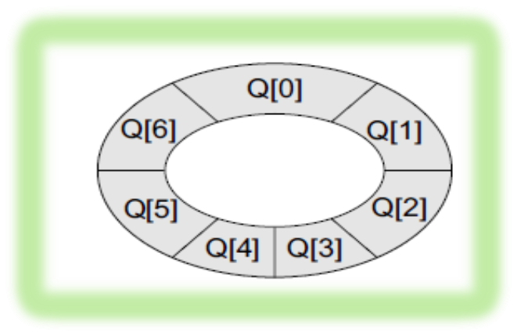
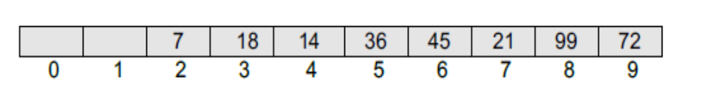
Circular Queue
In linear queues, we have discussed so far that insertions can be done only at one end called the REAR and deletions are always done from the other end called the FRONT.
If we want to insert another value, it will not be possible because the queue is completely full.
There is no empty space where the value can be inserted.
Consider a scenario in which two successive deletions are made. Here, front = 2 and REAR = 9.
Even though there is space available, the overflow condition still exists because the condition rear = MAX – 1 still holds true.
This is a major drawback of a linear queue.
In the circular queue, the first index comes right after the last index. Conceptually, you can think of a circular queue as shown in Fig

Slide 52
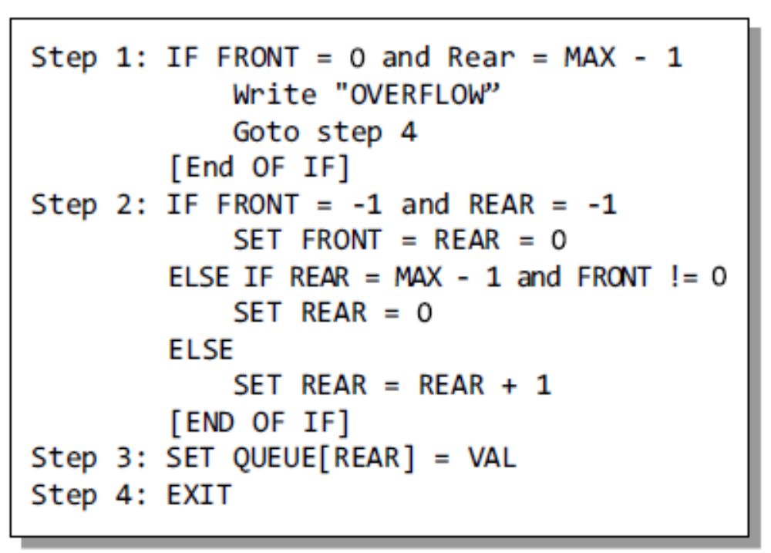
Algorithm To Insert Element into a Circular Queue

Slide 53

DEQUEUE
A deueue is a list in which the elements can be inserted or deleted at either end. It is also known as a head-tail linked list because elements can be added to or removed from either the front (head) or the back (tail) end.
However, no element can be added and deleted from the middle. In the computer’s memory, a deque is implemented using either a circular array or a circular doubly linked list.
In a deque, two pointers are maintained, LEFT and RIGHT, which point to either end of the deque.
The elements in a deque extend from the LEFT end to the RIGHT end and since it is circular, Dequeue[N–1] is followed by Dequeue[0].
There are two variants of a deque:
Input restricted deque In this dequeue, insertions can be done only at one of the ends, while deletions can be done from both ends.
Output restricted deque In this dequeue, deletions can be done only at one of the ends, while insertions can be done on both ends.

Slide 54
Priority queue
A priority queue is a data structure in which each element is assigned a priority. The priority of the element will be used to determine the order in which the elements will be processed. The general rules of processing the elements of a priority queue are :
An element with higher priority is processed before an element with a lower priority.
Two elements with the same priority are processed on a first-come-first-served (FCFS) basis.
A priority queue can be thought of as a modified queue in which when an element has to be removed from the queue, the one with the highest-priority is retrieved first. The priority of the element can be set based on various factors.

Slide 55
Priority queue Example
Priority queues are widely used in operating systems to execute the highest priority process first. The priority of the process may be set based on the CPU time it requires to get executed completely.
For example, if there are three processes, where the first process needs 5 ns to complete, the second process needs 4 ns, and the third process needs 7 ns, then the second process will have the highest priority and will thus be the first to be executed.
CPU time is not the only factor that determines the priority, rather it is just one among several factors. Another factor is the importance of one process over another.
In case we have to run two processes at the same time, where one process is concerned with online order booking and the second with printing of stock details, then obviously the online booking is more important and must be executed first.

Slide 56
Ways to implement a priority queue.
There are two ways to implement a priority queue.
We can either use a sorted list to store the elements so that when an element has to be taken out, the queue will not have to be searched for the element with the highest priority
We can use an unsorted list so that insertions are always done at the end of the list. Every time when an element has to be removed from the list, the element with the highest priority will be searched and removed.
While a sorted list takes O(n) time to insert an element in the list, it takes only O(1) time to delete an element.

Slide 57
Applications of Queues
Queues are widely used as :
waiting lists for a single shared resource like printer, disk, CPU.
Queues are used to transfer data asynchronously (data not necessarily received at same rate as sent) between two processes (IO buffers), e.g., pipes, file IO, sockets.
Queues are used as buffers on MP3 players and portable CD players, iPod playlist.
Queues are used in Playlist for jukebox to add songs to the end, play from the front of the list.
Queues are used in operating system for handling interrupts. When programming a real-time system that can be interrupted, for example, by a mouse click, it is necessary to process the interrupts immediately, before proceeding with the current job. If the interrupts have to be handled in the order of arrival, then a FIFO queue is the appropriate data structure.

